Slide 1

Assessment Self-Presentation
Software Architecture L1
Pavlo Vilenchyk
November 2025

Slide 2
Introduction – Who I am
Current title: Lead Software Engineer
Current roles: Technical Lead and SME responsible for system analysis, modernization design, and migration of AS400 mainframe, components, ETL pipelines, and financial systems. Lead cross-team collaboration, guide technical decisions, and ensure scalable, reliable, and business-aligned solutions that support SafeRent’s long-term platform evolution.
Key Skills:
Legacy System Modernization Architecture
End-to-End Solution Design
Technical Leadership & SME Expertise
Enterprise Migration Strategy
Cross-Team Collaboration & Stakeholder Alignment
Data Integration & ETL Architecture
Certificates/Educational Programs:
Solution Architecture School #177 2024Q4 (US/CA)
Azure AZ-204 Cloud Developer
Implementing a Data Warehouse
Databricks fundamentals

Slide 3
Working Experience/Career Path
2008
Ukrainian Media Holding – Web solutions
Korrespondent.net football.ua (Solutions architect)
Title: CTO
2016
EPAM – CLGX-RPS (Team Lead)
Title: Lead Software Engineer
2023– present
EPAM – SFRN-DEVT (Team Lead, SME)
Title: Lead Software Engineer
2015
EPAM – EPM-RQUA (Key developer)
Title: Project Manager
2020
EPAM – CLGX-RPSM (Project Coordinator)
Title: Lead Software Engineer

Slide 4

Contribution to projects and achievements
EPAM – SFRN-DEVT:
Architectural Discovery & Design Analysis
Joined the project at its inception and led the discovery phase during the transition to EPAM.
Conducted deep structural analysis of legacy RPS components through collaboration with existing vendors, RPS architects, and business stakeholders.
Produced architectural documentation and diagrams that served as the blueprint of future modernization.
AS400 UI & Interface Modernization
Designed architecture for migrating AS400 RPG apps into a modern Angular SPA platform.
Ensured a dual-environment setup, supporting multiple databases simultaneously and enabling a smooth, low-risk transition to the new system.
The solution remains in production and continues to evolve, validating the robustness and forward-looking nature of the architecture.

Slide 5
Contribution to projects and achievements
EPAM – SFRN-DEVT:
Transition to EPAM Managed Services
Played a key role in preparing the full transition from third-party vendors to EPAM’s managed-services model.
Created complete system architecture diagrams and documented responsibilities across all vendor and internal teams.
Supported the migration of SRS solutions from the corporate CoreLogic environment to a dedicated client data center.
With clear documentation and architectural planning, the data-center transition was completed in six months, with me acting as SME for .NET and DB solutions.
was
main
Was

Slide 6
Contribution to projects and achievements
EPAM – SFRN-DEVT:
Data Flow & ETL Migration (SSIS / Pentaho)
Led a team of 10 developers to migrate AS400 jobs and custom tooling into standardized SSIS and Pentaho ETL workflows.
Developed a detailed WBS, conducted migration planning, and guided the team on data-flow design.
Demonstrated tech expertise across legacy systems, ETL pipelines, and modern data-integration patterns.
Billing System Migration (Oracle Fin → Sage Intacct)
Acted as SME and Software Architect for the full financial-system migration initiative.
Designed and oversaw data extraction, transactional capture, transformation/normalization to Intacct’s data model, and integration adaptation.
Managed parallel run, validation cycles, cutover execution, and post-migration support.
was
main
Was

Slide 7
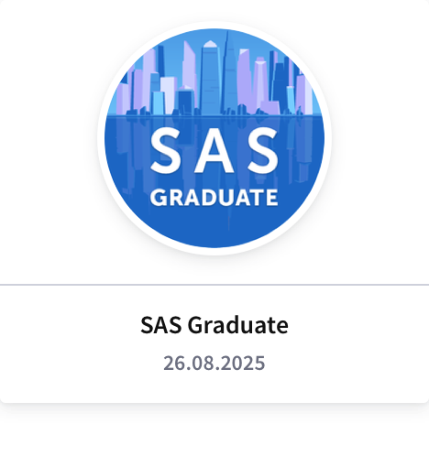
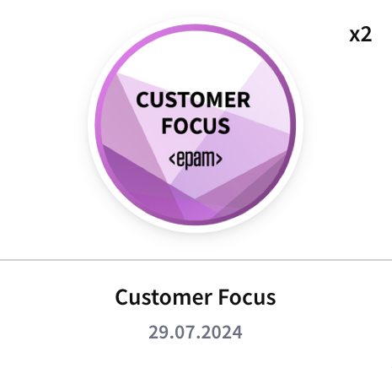
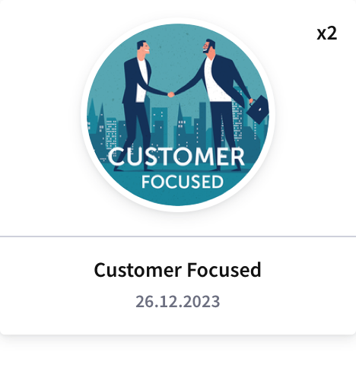
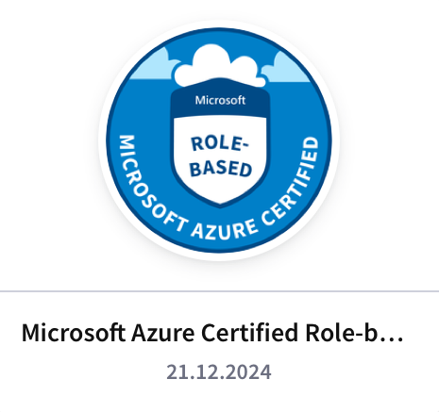

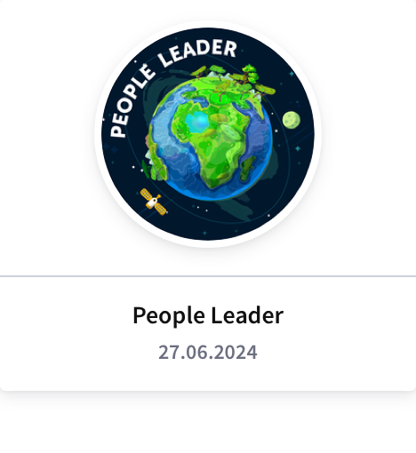
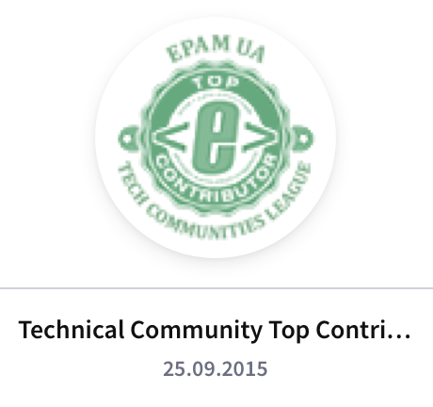

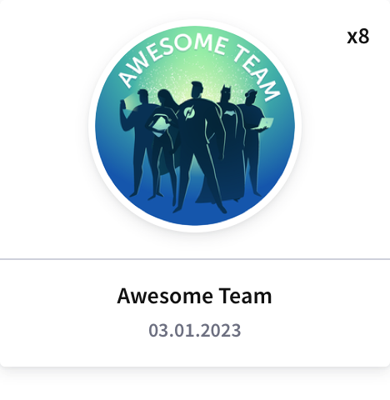
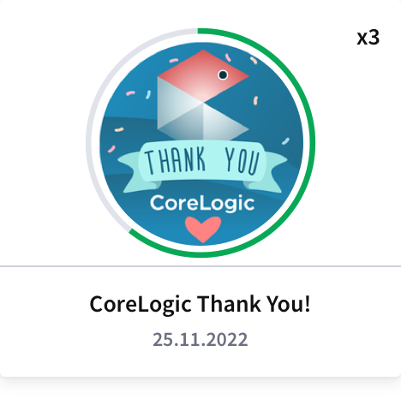
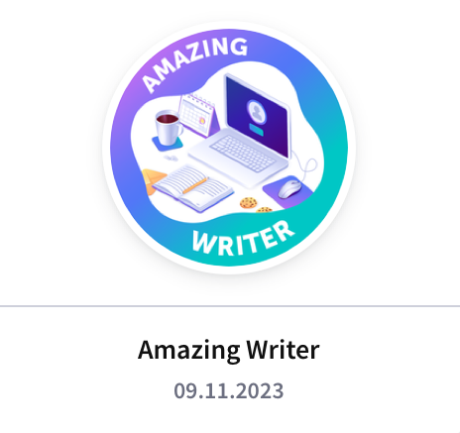
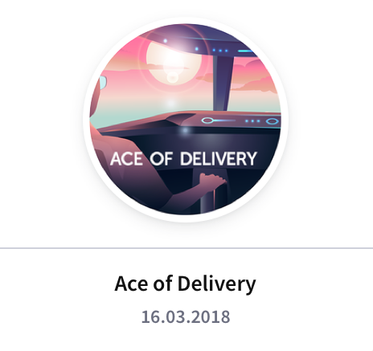
EPAM Badges

Slide 8
Summary – justification for promotion, goals for future
Demonstrated strong ownership of architecture and delivery across the SafeRent account, ensuring solutions align with business and engineering strategy.
Led legacy system discovery and modernization, defining scalable modern architectures.
Proactively identified and drove resolution of technical debt, generating additional value and revenue for EPAM.
Improved system maintainability, scalability, and reliability through clear architectural guidance and governance.
Effectively communicated with stakeholders, breaking down complex work and enabling timely, high-quality delivery.
Plan to expand architectural influence across more domains and strengthen governance and cloud-native modernization.
Aim to mentor engineering teams, drive innovation, and contribute to EPAM’s wider architecture community.

Slide 9
SFRN-DEVT: 2024. Client onboarding app. NewAccount
Business Drivers
Growing demand for faster, more accurate client onboarding across SafeRent Solutions.
Need to unify fragmented account-related interactions across Dynamics 365, Back-Office apps, Client-faced apps.
Pressure to improve operational efficiency, reduce onboarding errors, and increase customer satisfaction.
Business Goals
Standardize and automate the end-to-end client onboarding lifecycle.
Provide reliable, real-time synchronization of account data across all integrated systems.
Reduce manual processing and internal communication overhead for onboarding teams.
Increase transparency and traceability of onboarding status, actions, and notifications.
Ensure a scalable architecture capable of supporting long-term onboarding volume growth.
Business Objectives
Reduce the average onboarding completion time by at least 40% within 12 months.
Cut manual onboarding tasks performed by account managers by at least 50%.
Establish auditable, event-based communication flows (via Slack and internal logs) for all key onboarding milestones.
Deploy a modular, maintainable software architecture that supports iterative feature expansion.

Slide 10
SFRN-DEVT: 2024. NewAccount. NFR
Performance & Scalability
Support ≥50 concurrent onboarding sessions without degradation.
Horizontal scaling of API nodes; queue-based load smoothing for long-running actions.
Availability & Reliability
System uptime: ≥99% monthly for API and SPA.
No single point of failure: Redundant instances for API, queues, database.
Retry & idempotency: All integration calls (Dynamics, AAM, Slack) must be idempotent with retry policies.
Graceful degradation: If non-critical integrations fail (e.g., Slack), onboarding still proceeds with warnings.
Security & Compliance
Authentication: Federated via OAuth2/OIDC; short-lived tokens; refresh token rotation.
Secrets management: No secrets in code; all via secure GCP SM.
Usability & Accessibility
UI consistency: Follow internal design system; predictable flow.
Auditability & Traceability
Immutable history: Audit events must be immutable and stored for ≥3 years.
Operational traceability: Ability to reconstruct onboarding flows end-to-end.

Slide 11
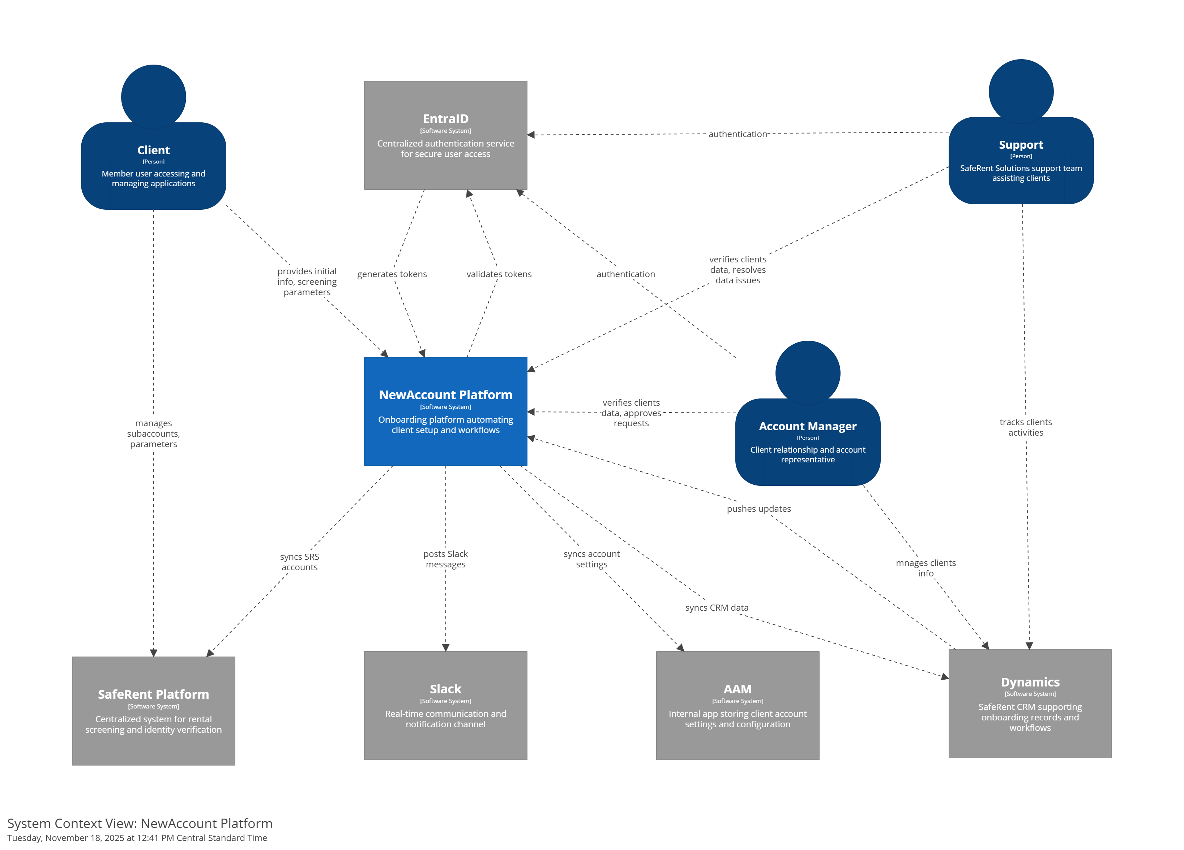
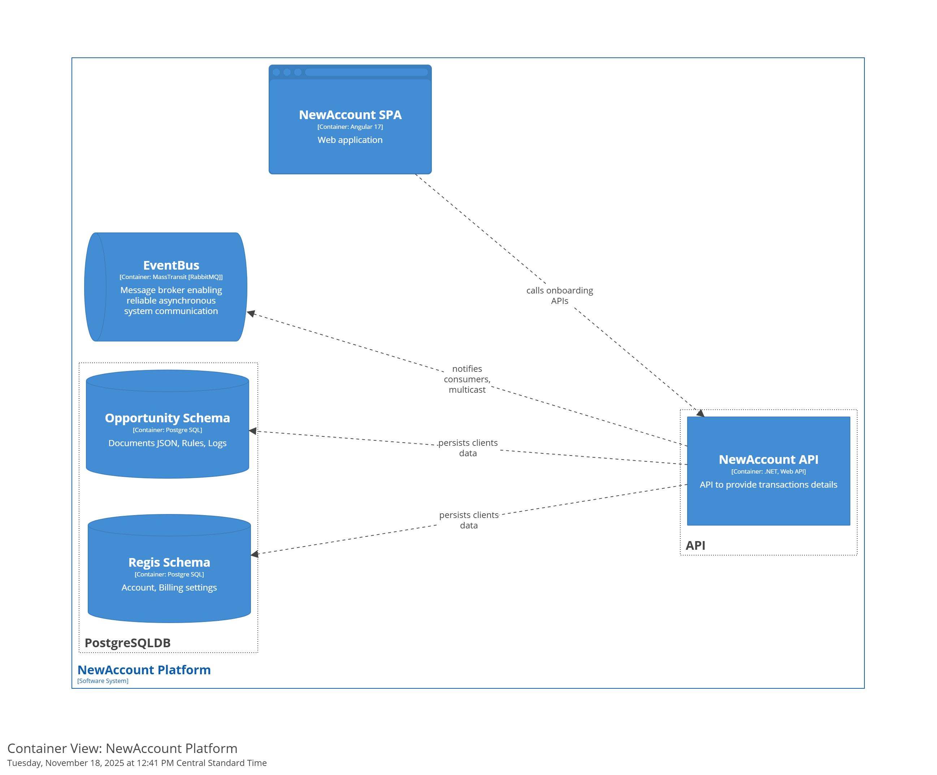
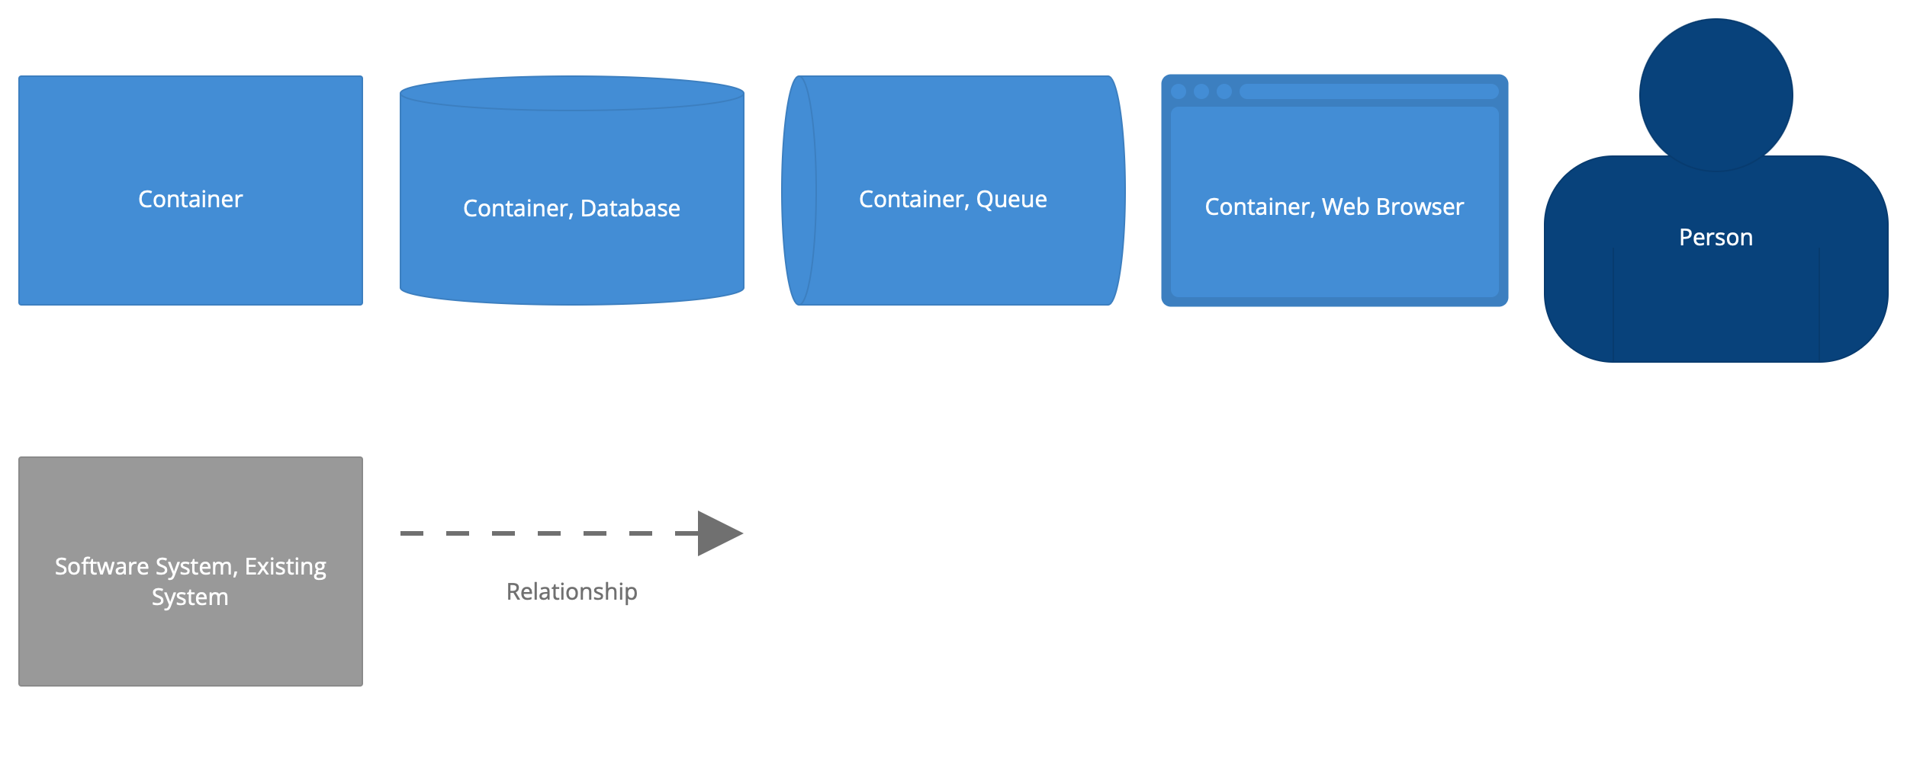
SFRN-DEVT: 2024. NewAccount. C4 diagrams
System context View
Container View

Slide 12
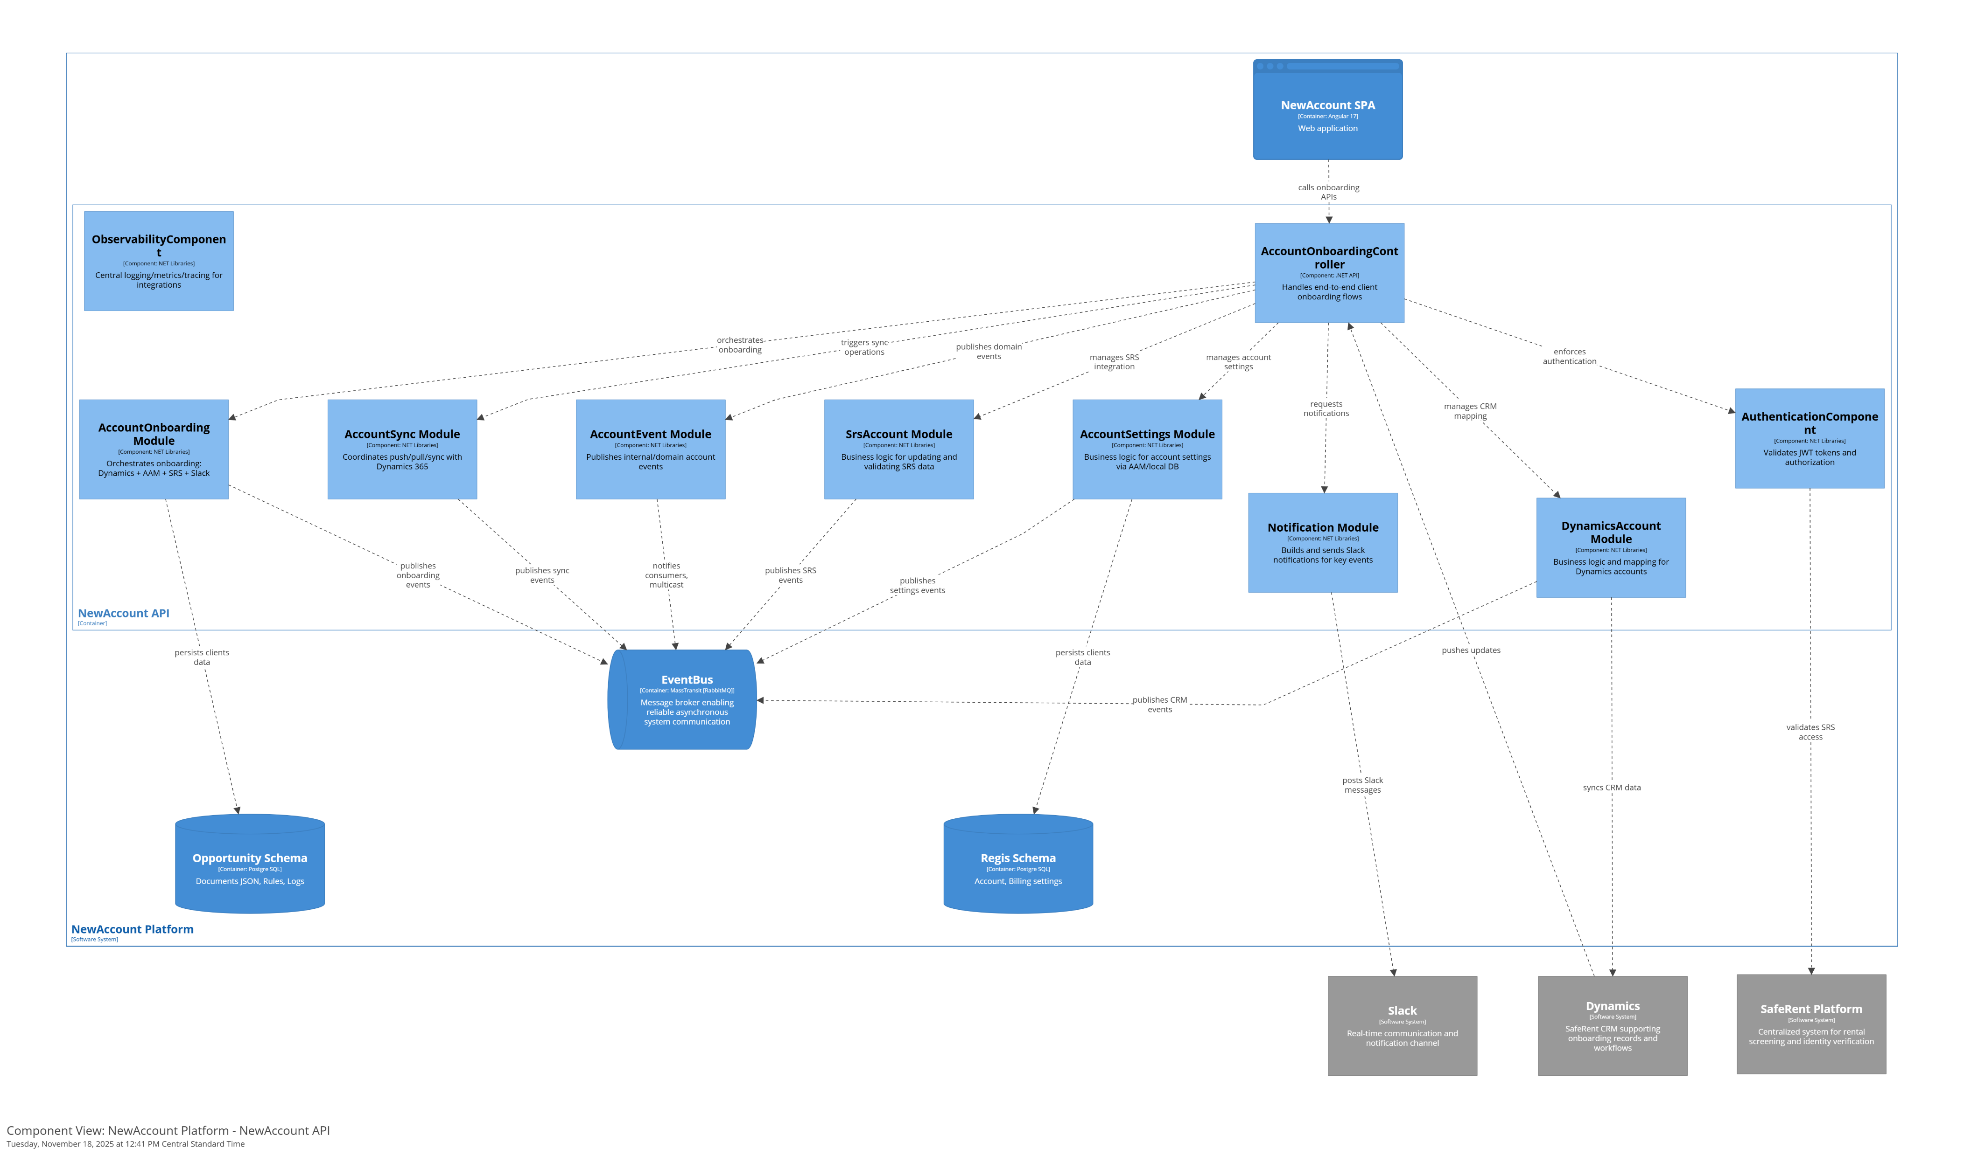
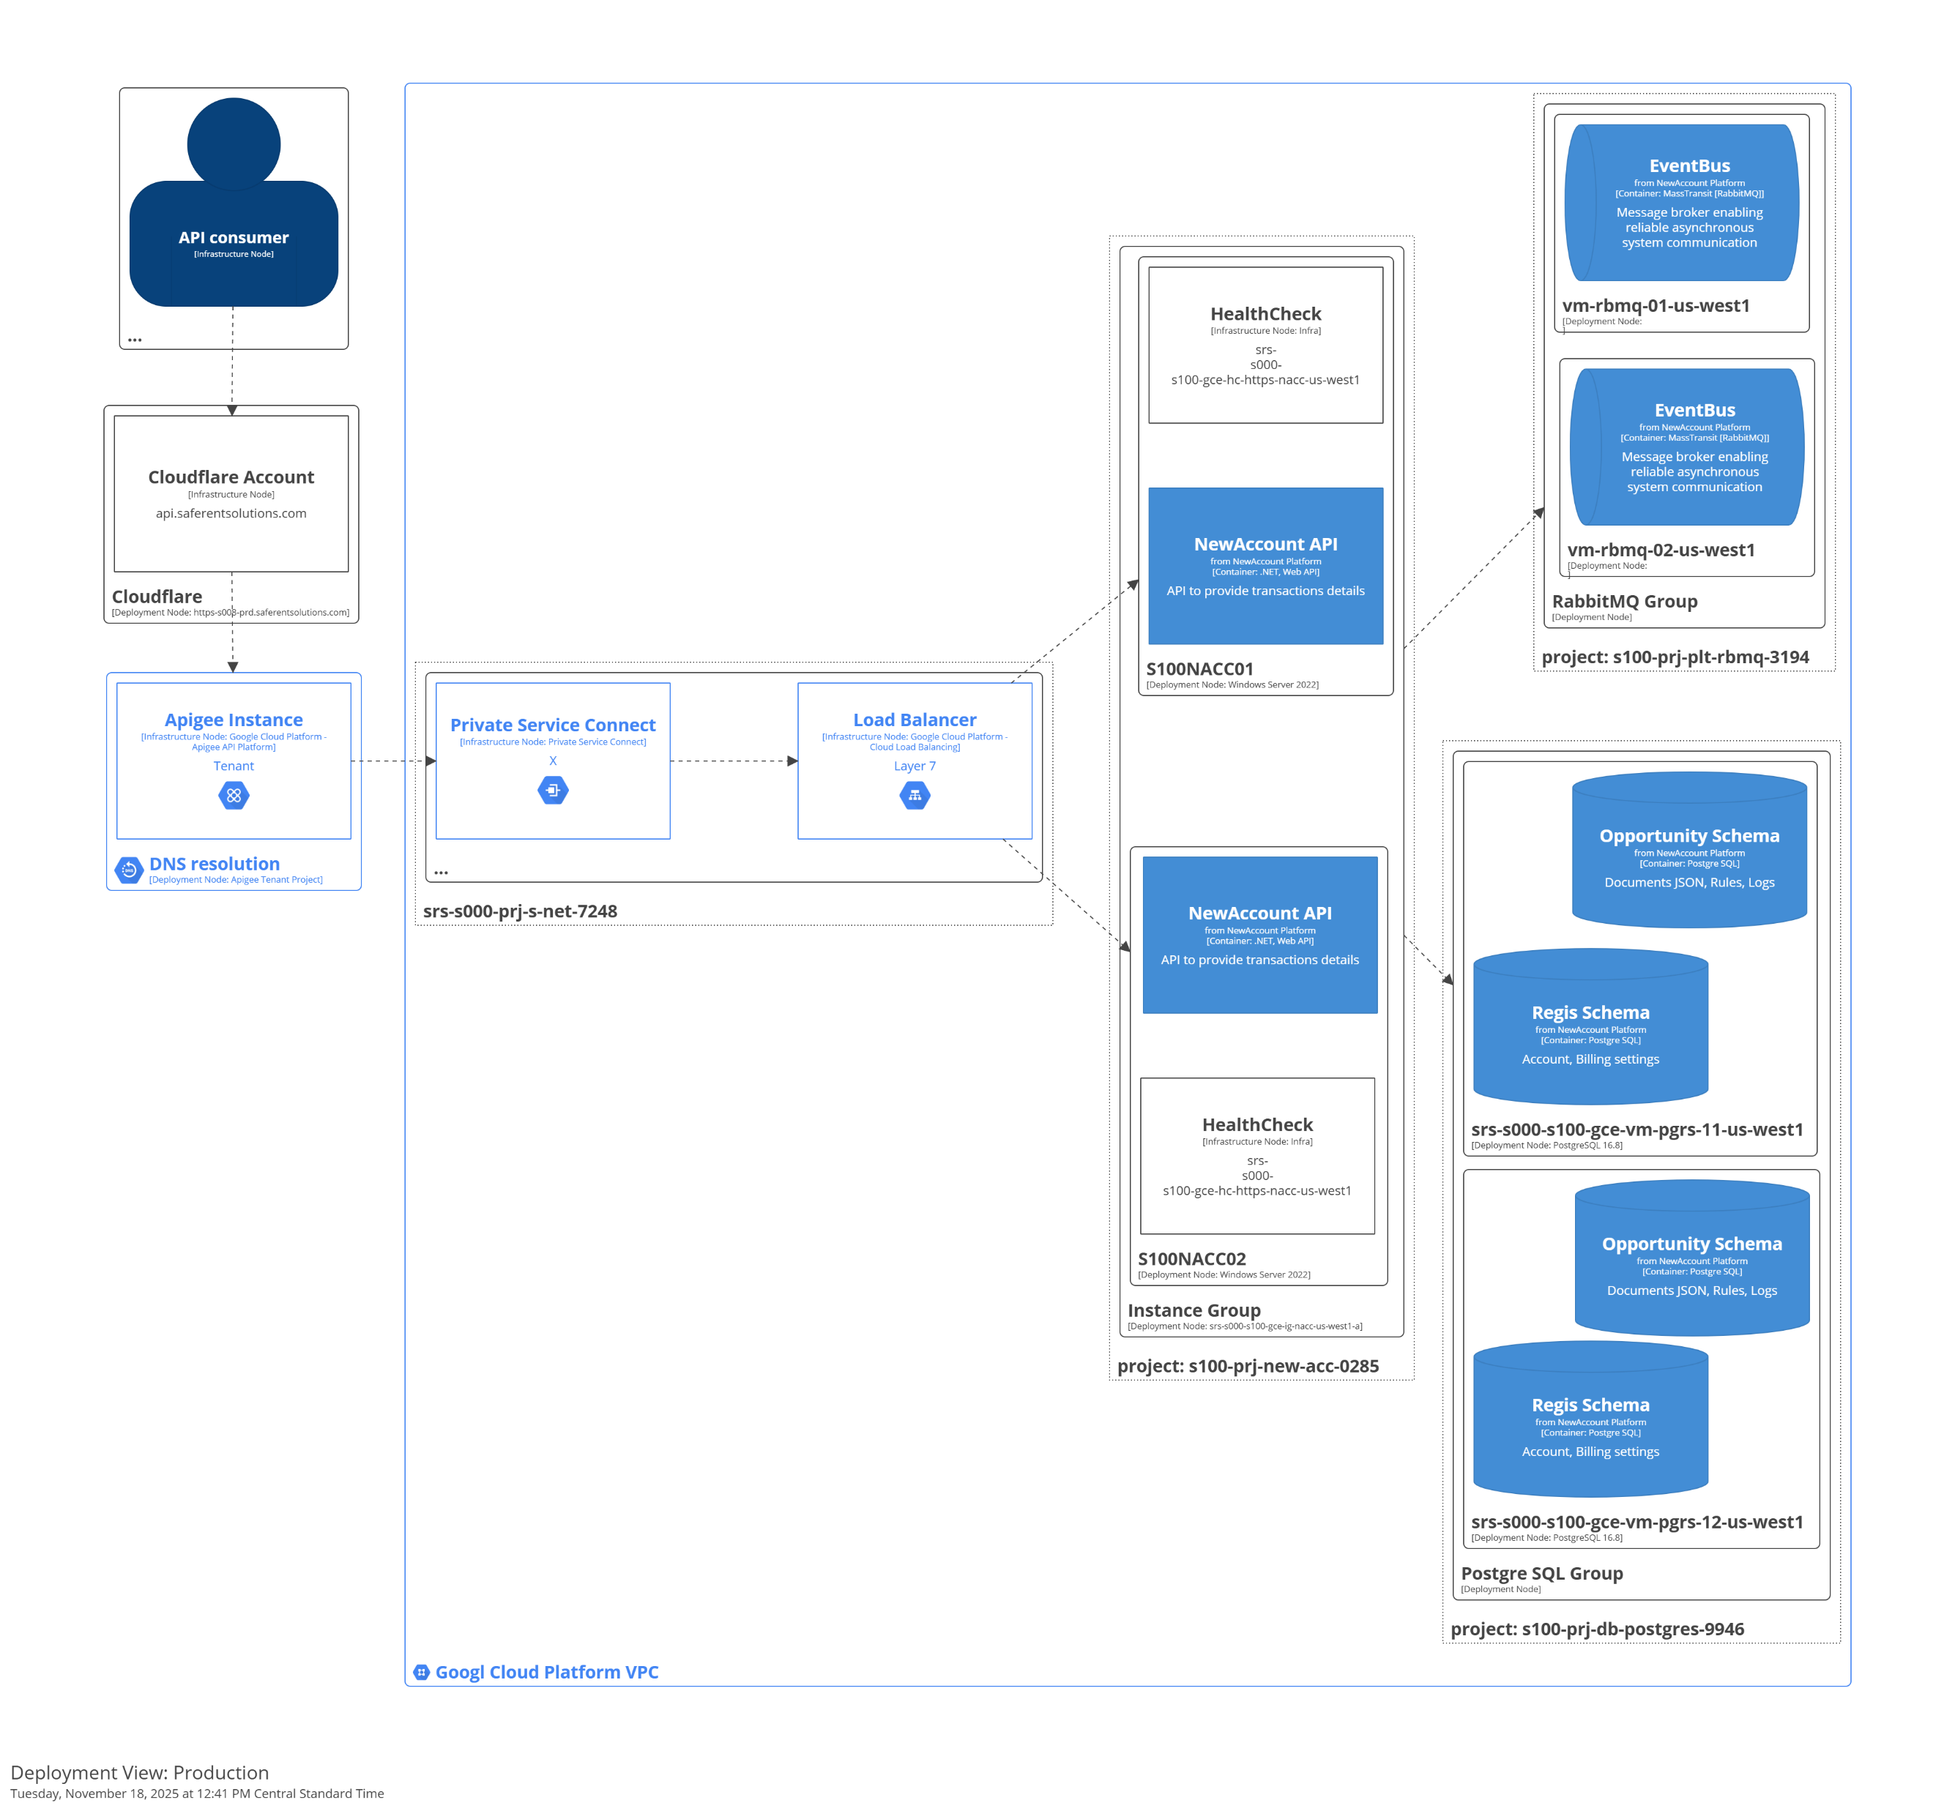
SFRN-DEVT: 2024. NewAccount. C4 diagrams
Component View
Deployment view

Slide 13
SFRN-DEVT: 2024. New Account
Architecture patterns:
Modular Monolith — Single deployable app with isolated modules.
Vertical Slices — Group code by feature/use case.
CQRS — Separate read/write models for scalability.
Routing Slip — Choreography pattern. Dynamic workflow routing through sequential steps.
Outbox/Inbox pattern – Reliable async messaging with transactional outbox.
Project outcomes:
Accelerated Client Onboarding — Cuts total onboarding time roughly 35%.
Improved Data Consistency — Ensures accurate, aligned client data across integrated systems.
Seamless System Integrations — Connects Dynamics, AAM, and SRS reliably with 99.9% uptime.
Lower Manual Effort — Automation removes nearly 30% of repetitive operational work company-wide.
Real-Time Process Visibility — Provides transparent, immediate insight into onboarding status with under-five-second updates.
Flexible Workflow Architecture — Adapts to evolving business needs using modular, scalable patterns supporting future transactional growth.

Slide 14
SFRN-DEVT: 2025. Single Sign-On solution
Business Drivers
Clients expect modern, frictionless login.
Rising security expectations from clients and partners.
Too many credential stores increase support load.
Industry shift toward standards-based integrations.
Business Goals
Deliver a unified and simplified login experience for all user groups.
Strengthen security and compliance through centralized identity management.
Reduce operational overhead by consolidating user stores and authentication flows.
Business Objectives
Unify all SafeRent applications authentication flows under a single SSO platform to provide a consistent user experience for clients.
Improve security by enforcing modern standards (OIDC, SAML, MFA, centralized policies) and eliminating outdated authentication methods
Reduce the number of independent user credential stores from multiple databases to a single authoritative identity provider
Enable seamless integration with external partner IdPs and PMS systems (e.g., Yardi, MRI, Appfolio)
Decrease onboarding and support costs by streamlining account creation, automating identity lifecycle processes, and minimizing password-related support tickets.

Slide 15
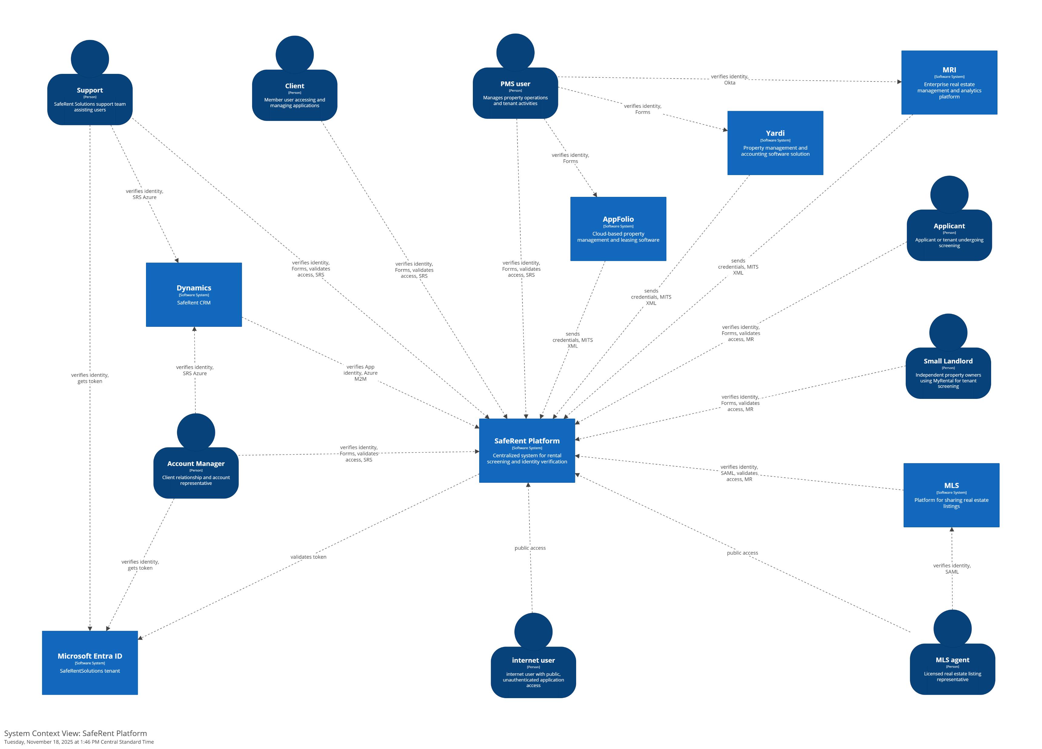
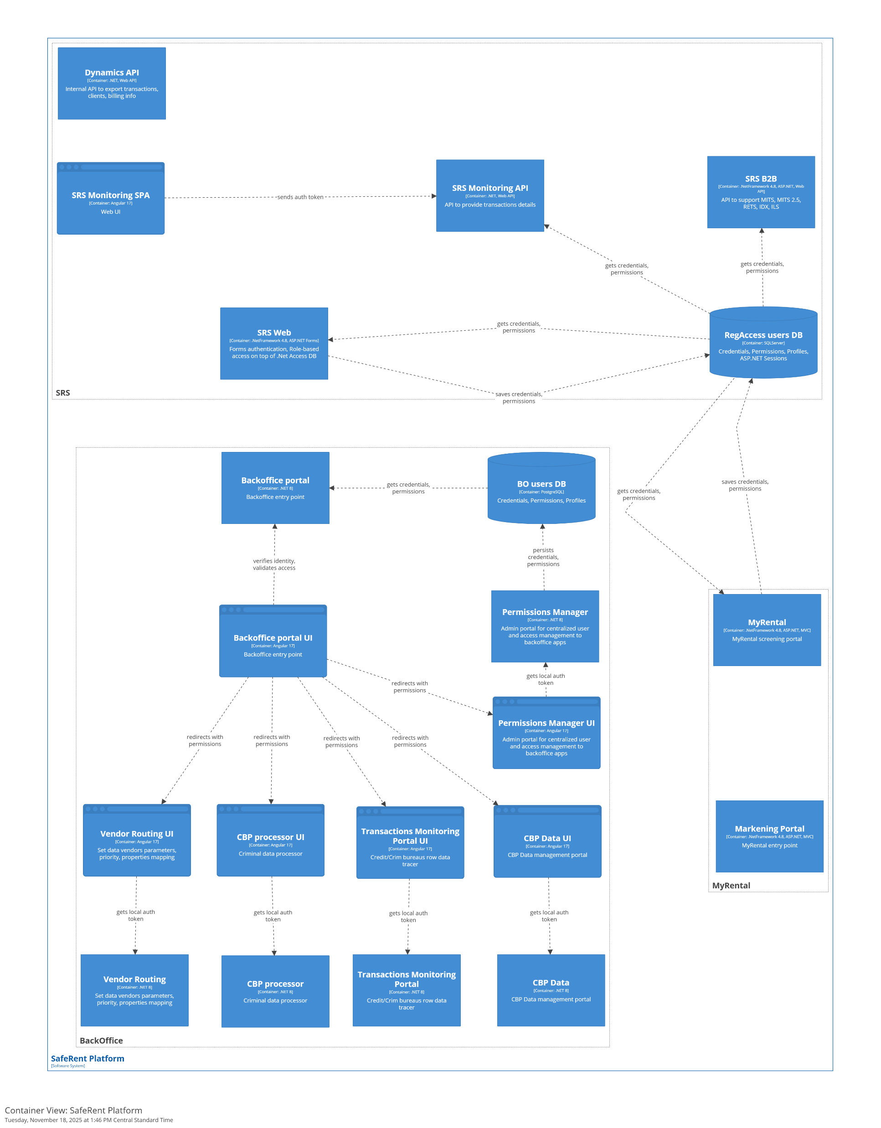

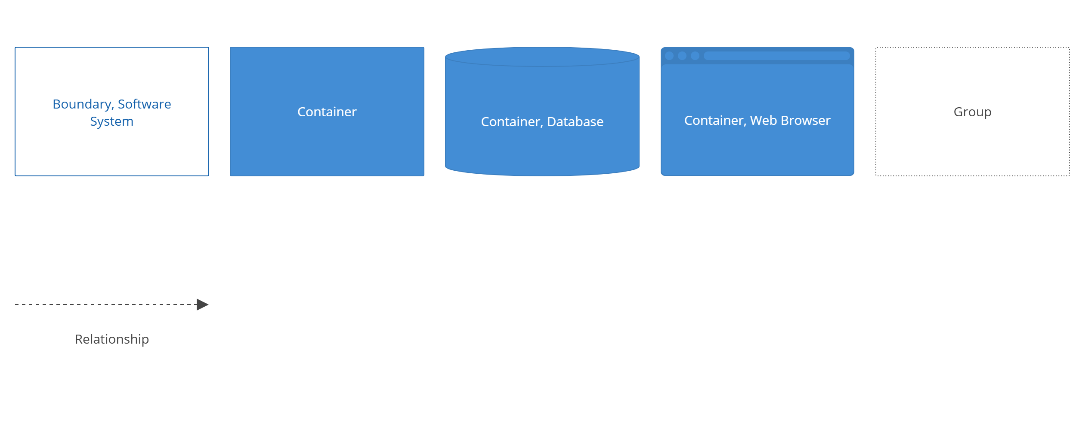
SFRN-DEVT: 2025. Pre-SSO
System context View
Container View

Slide 16
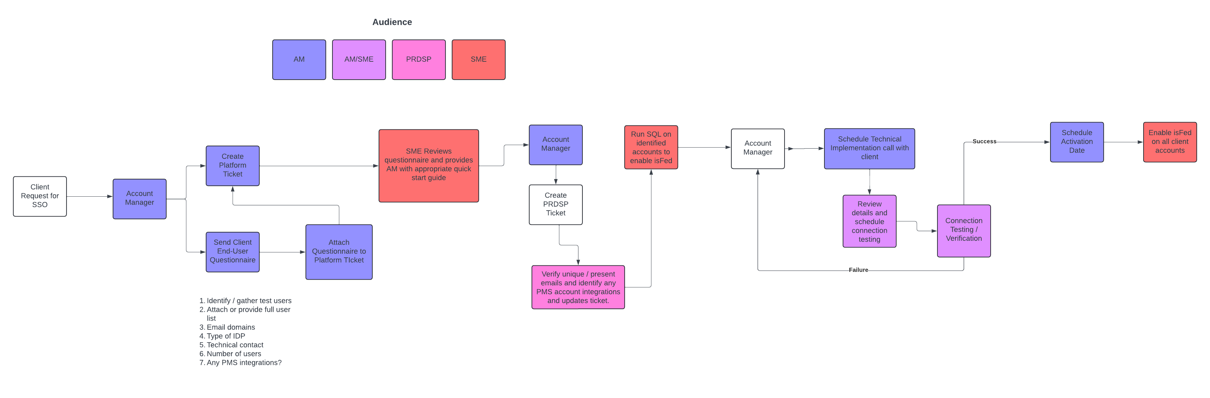
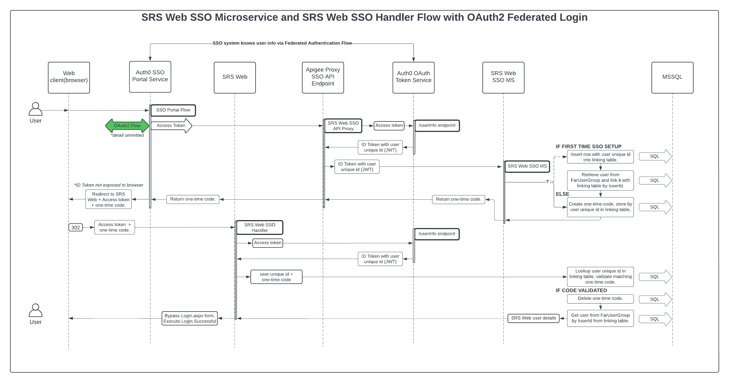
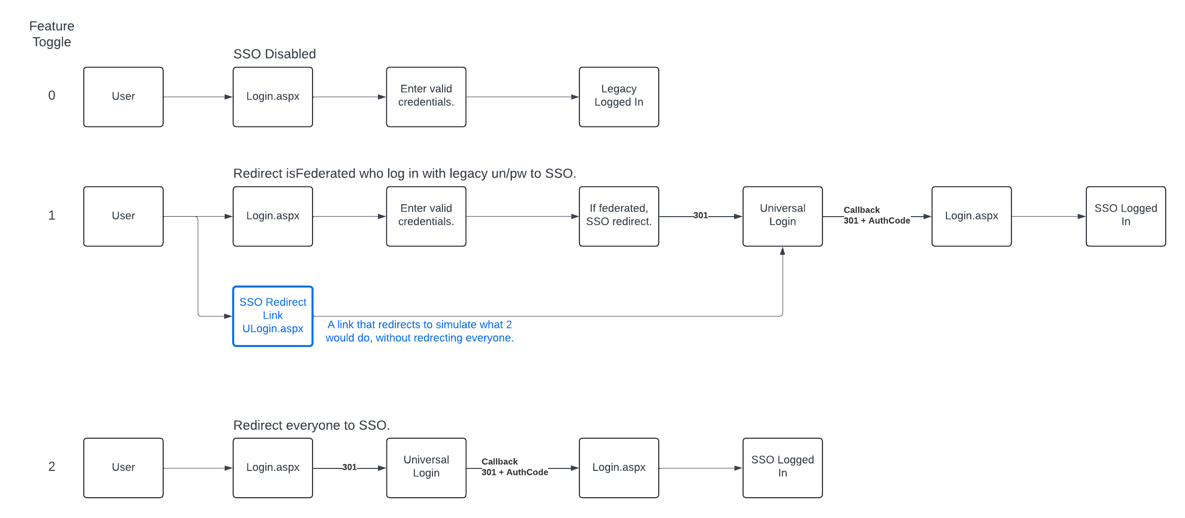
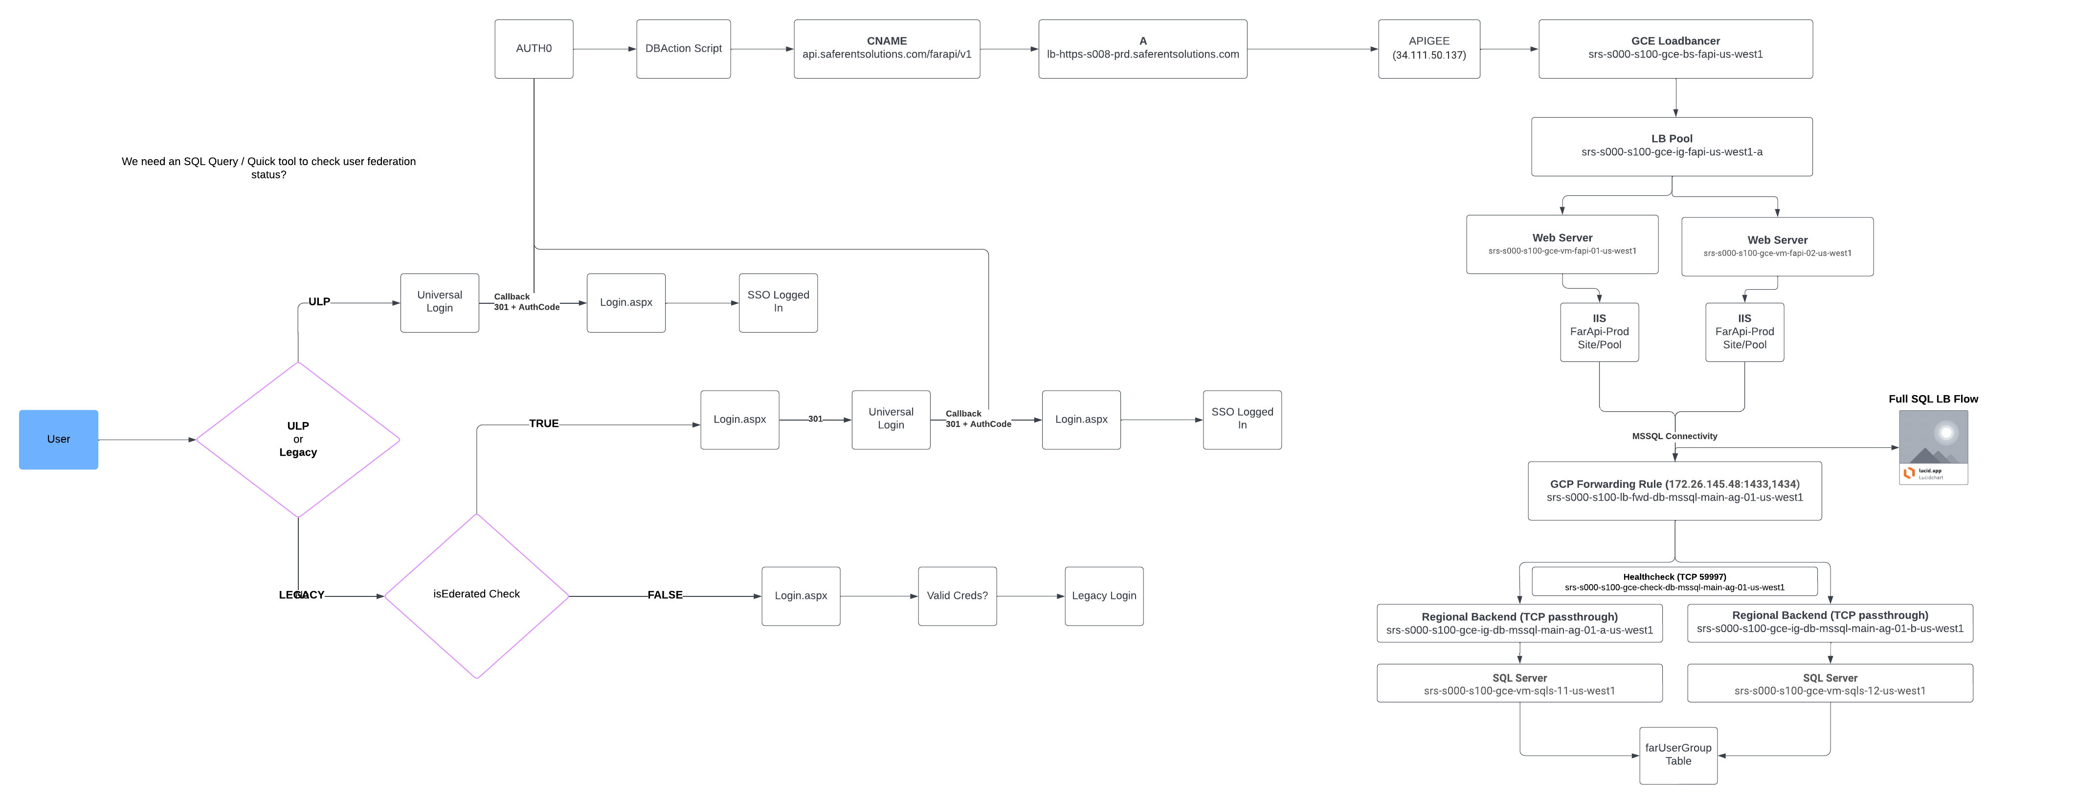
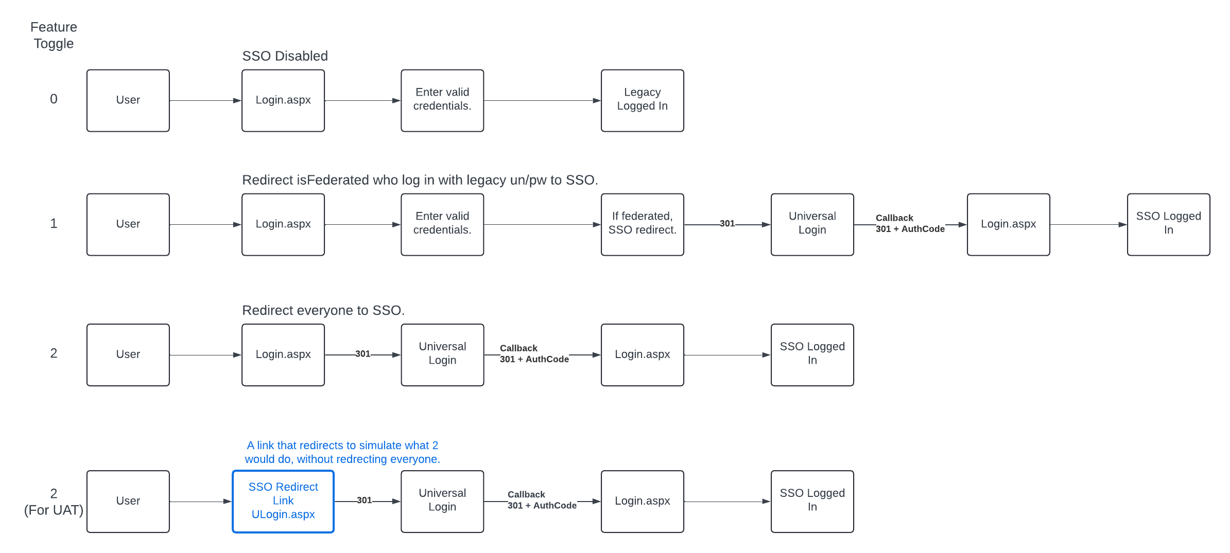
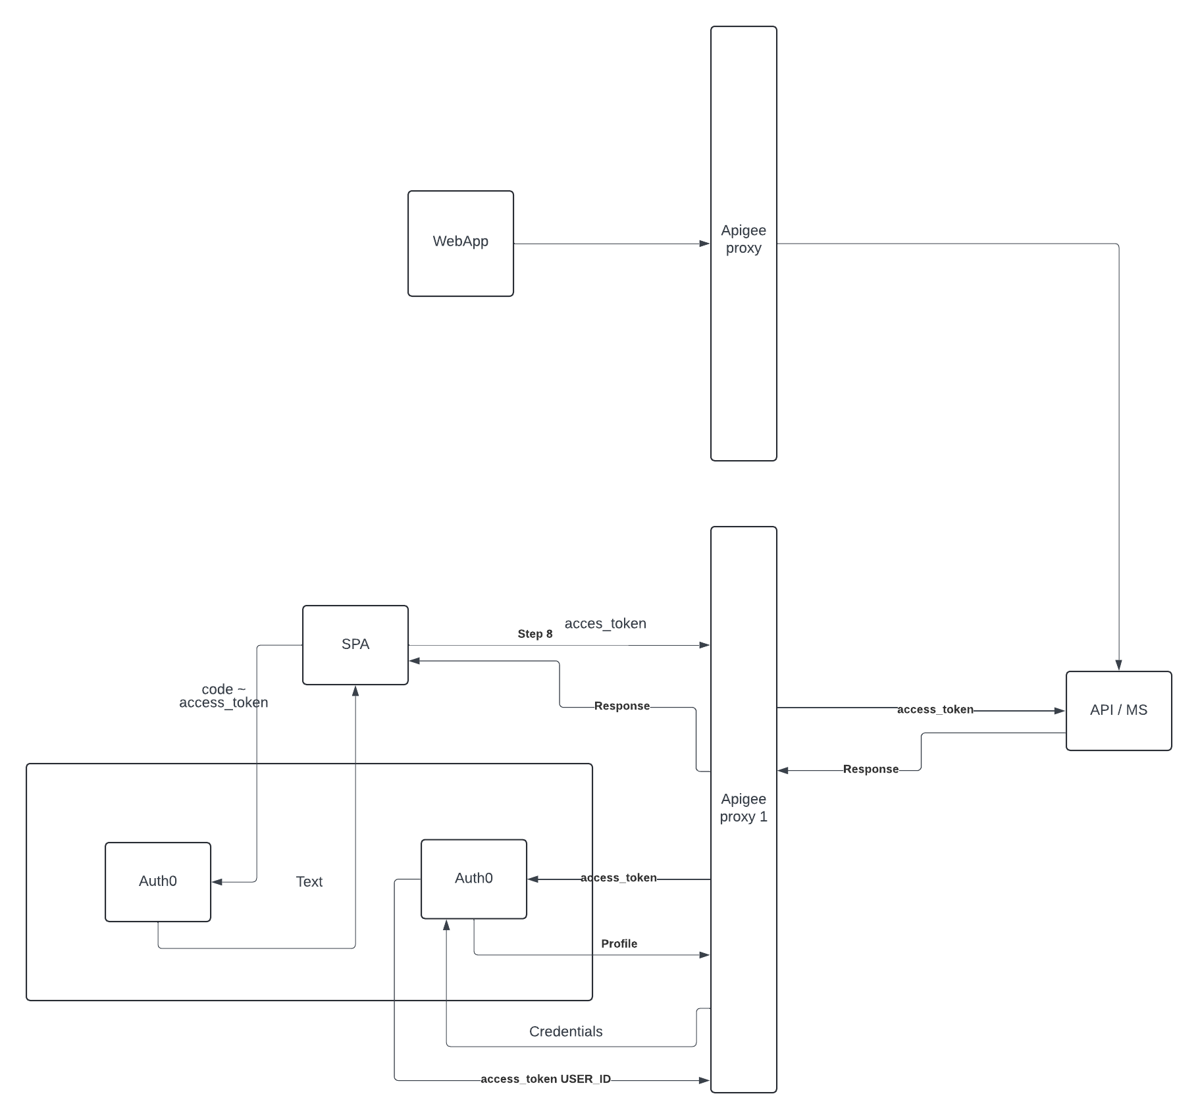
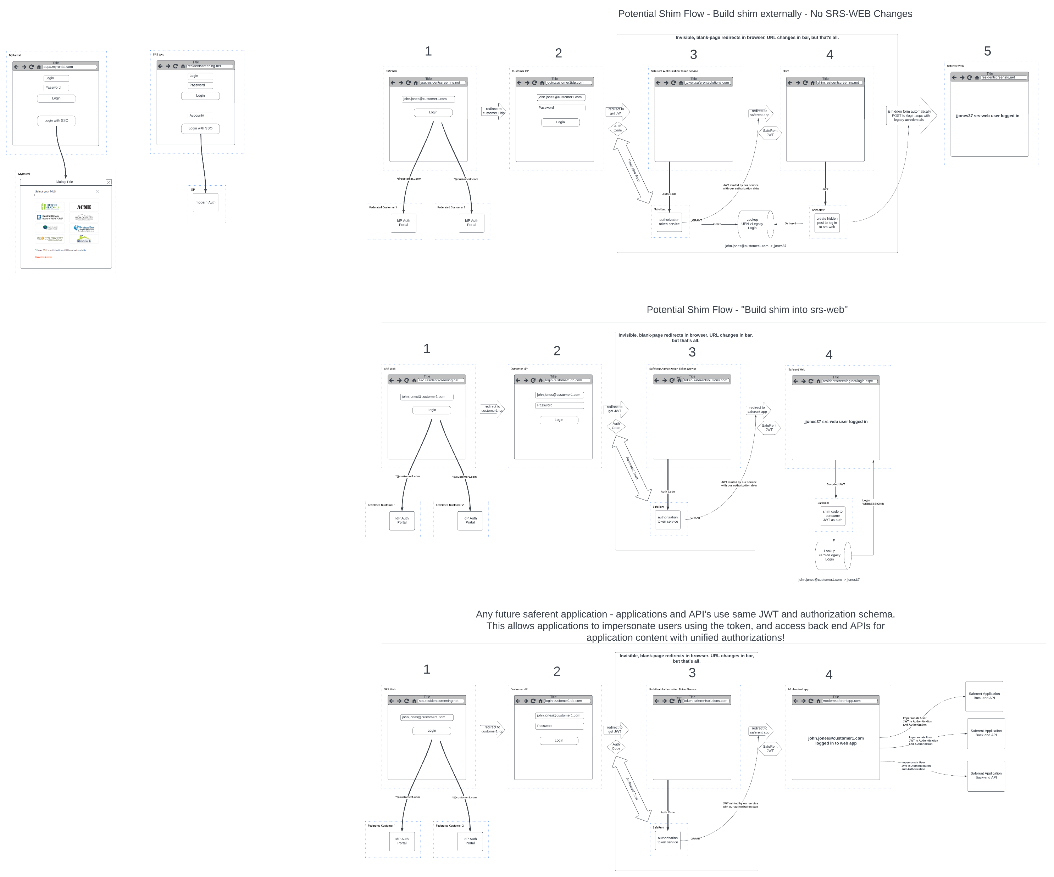
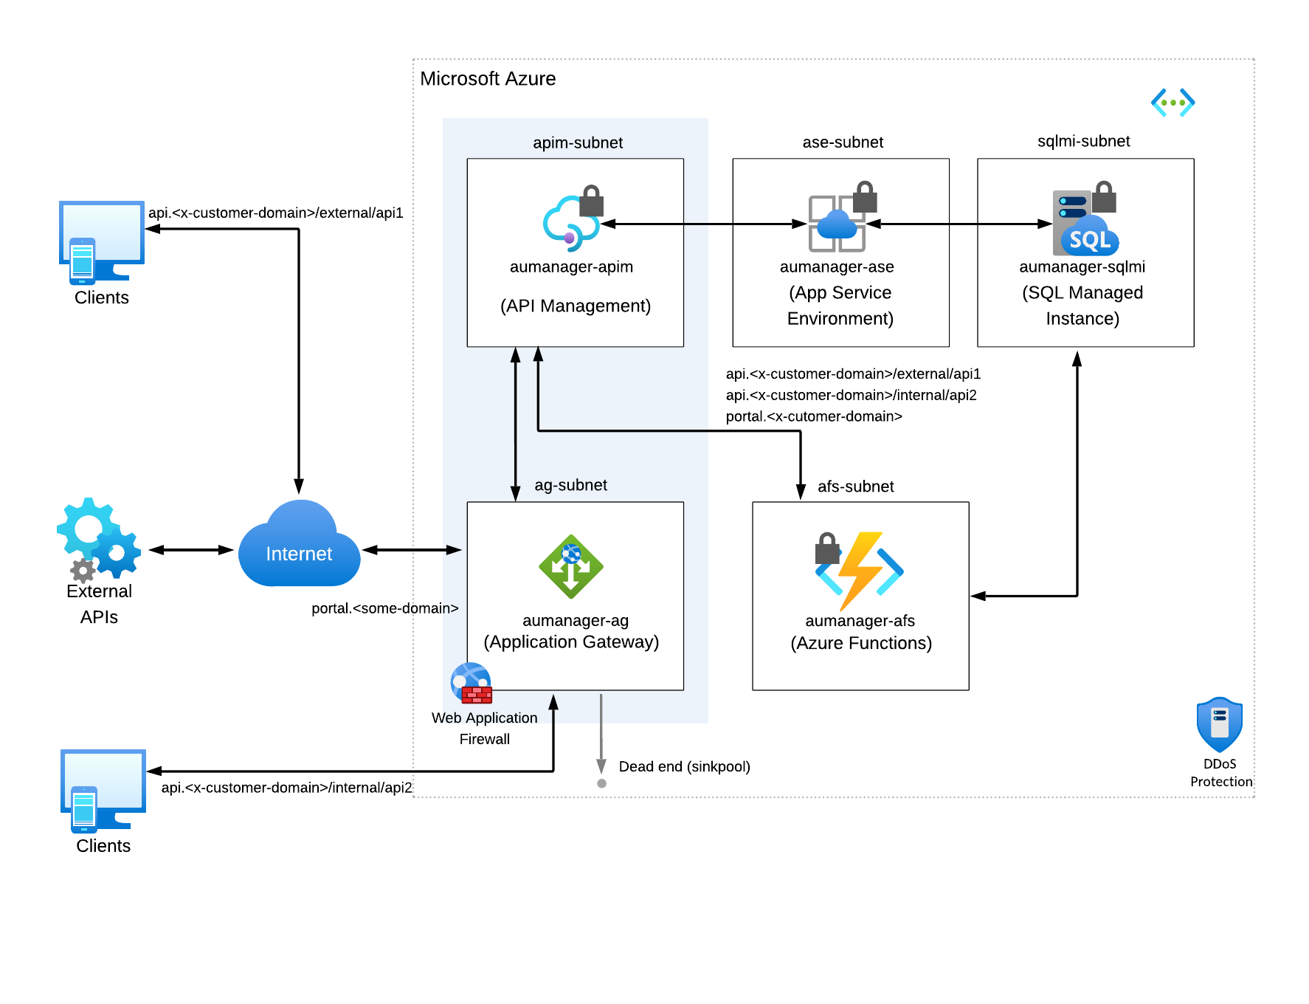
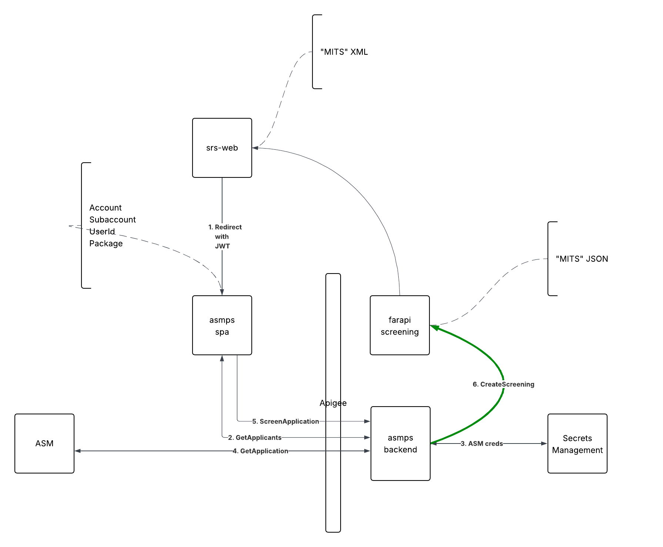
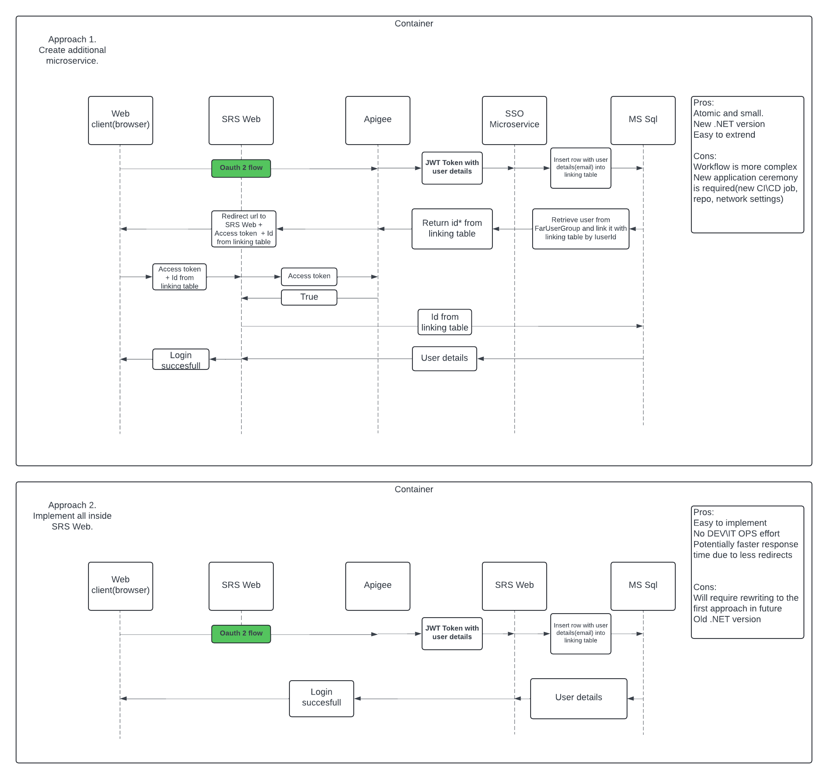
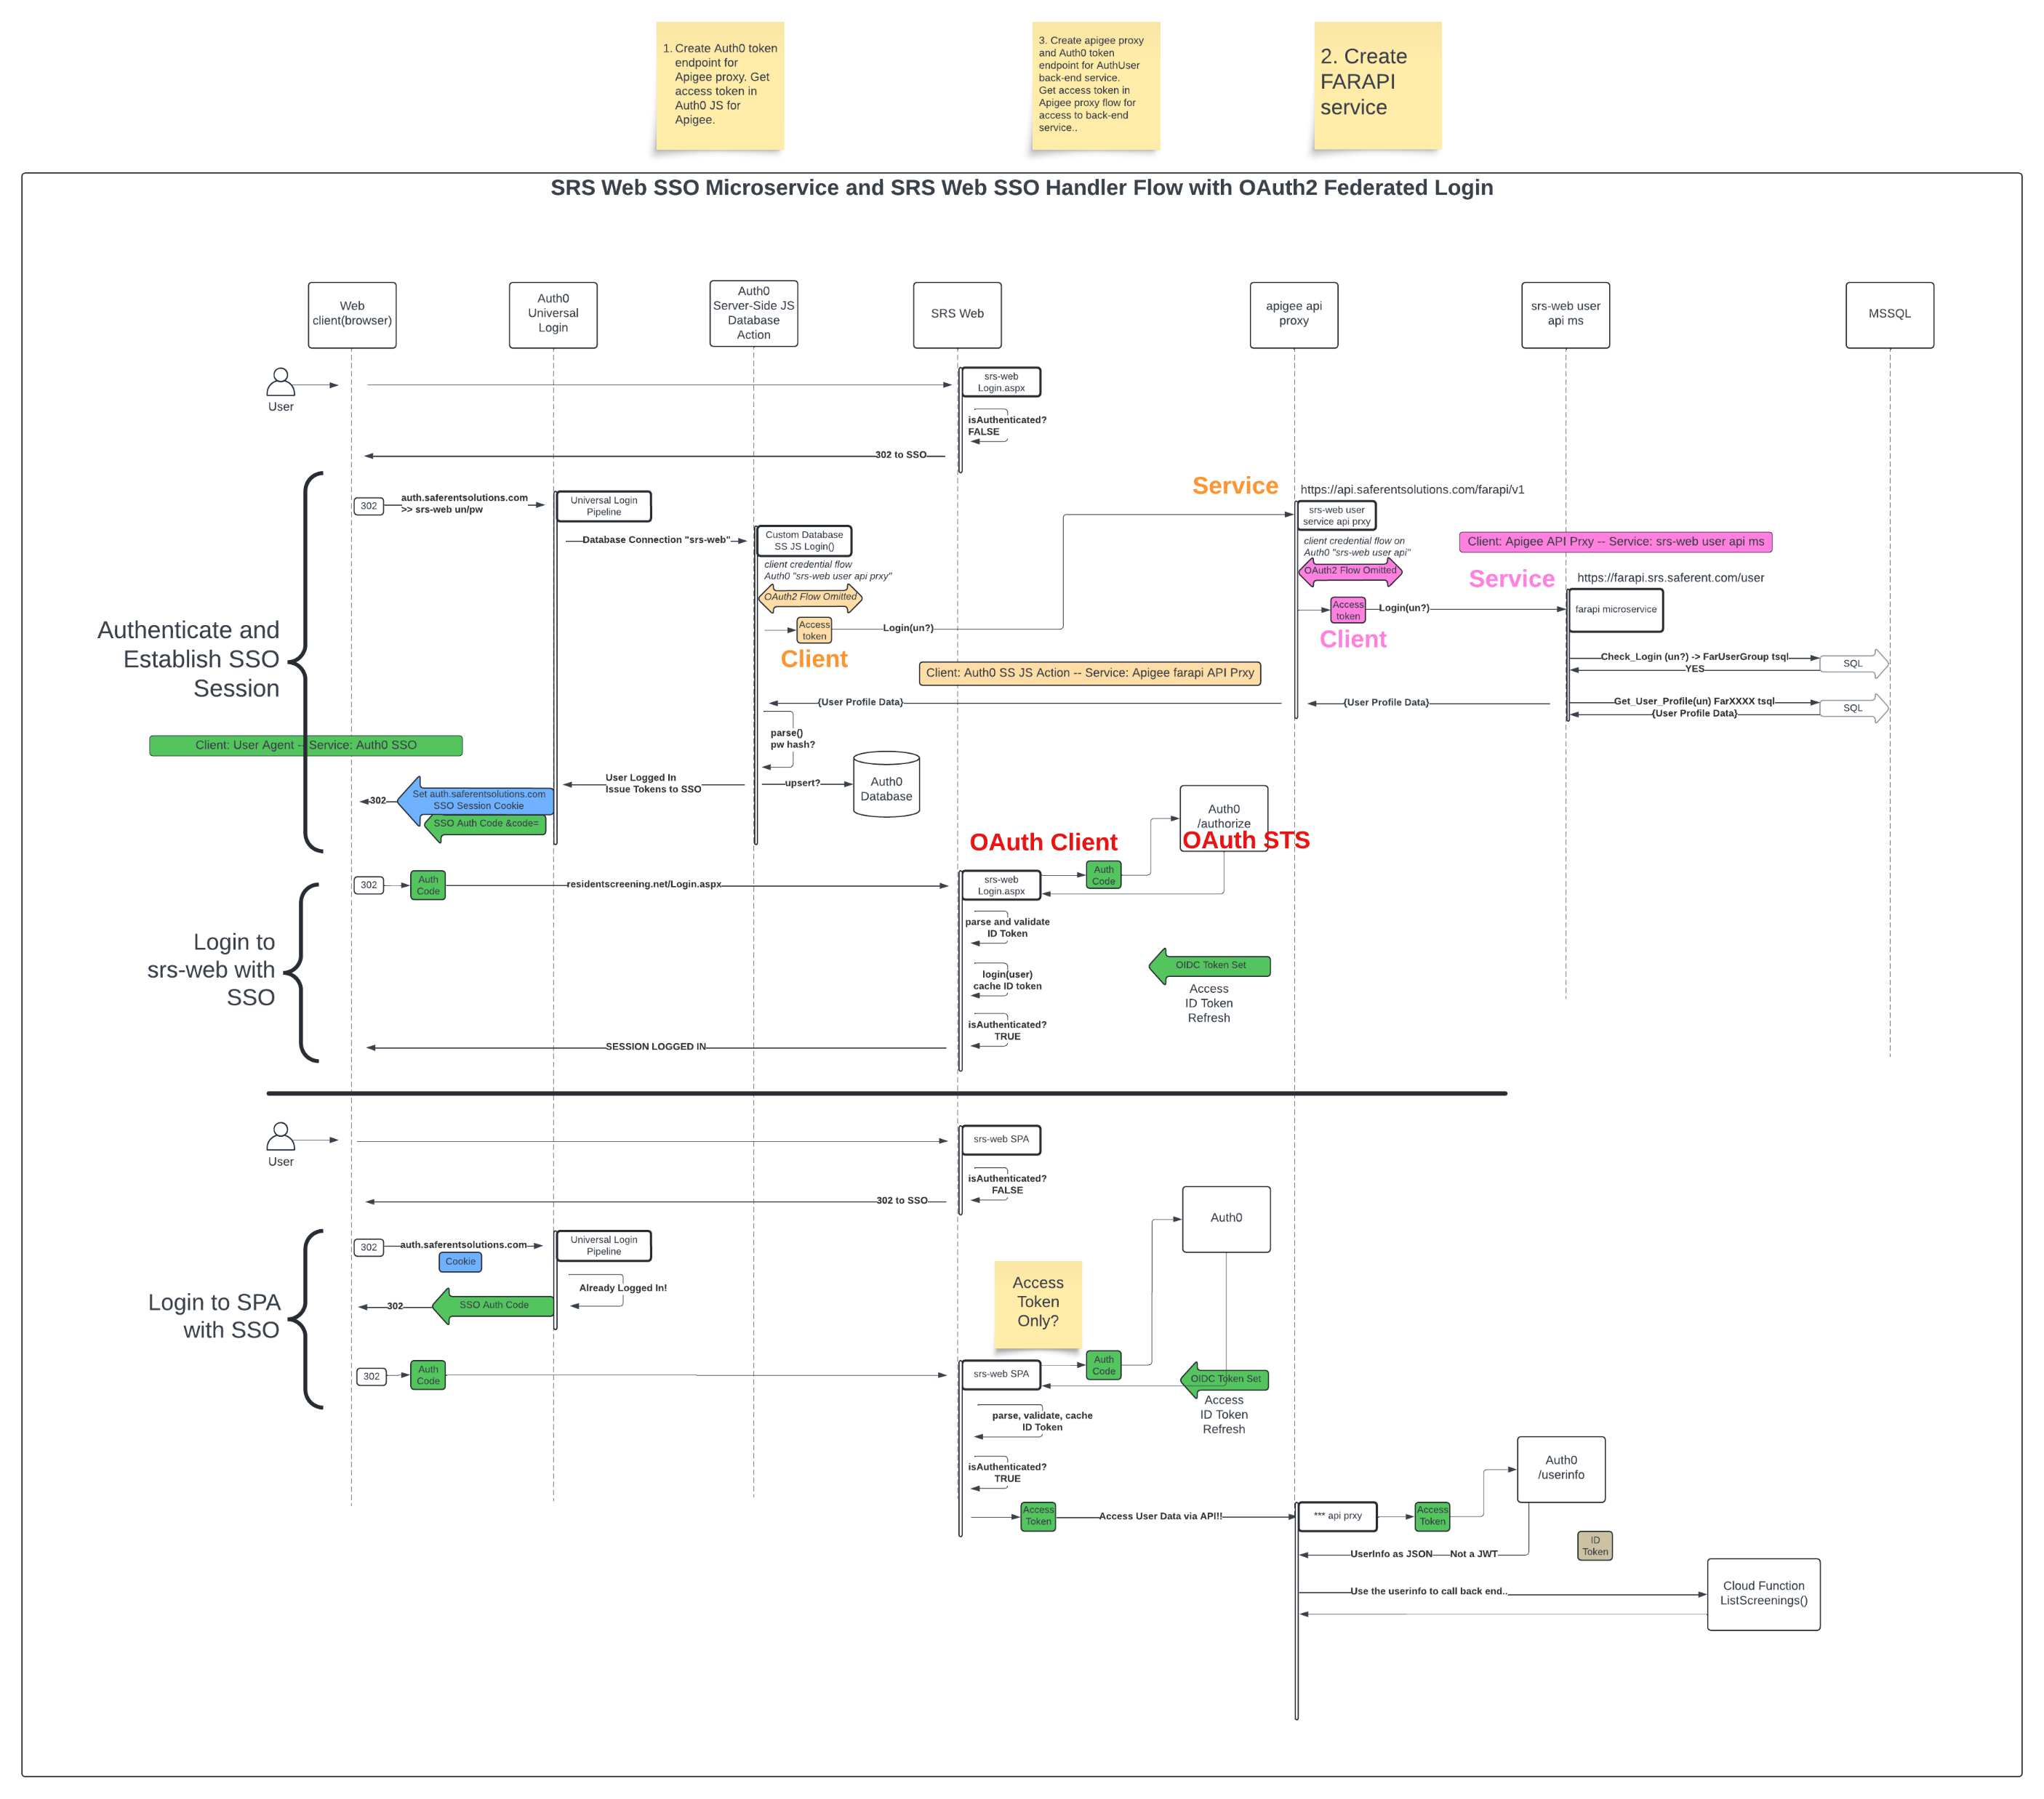
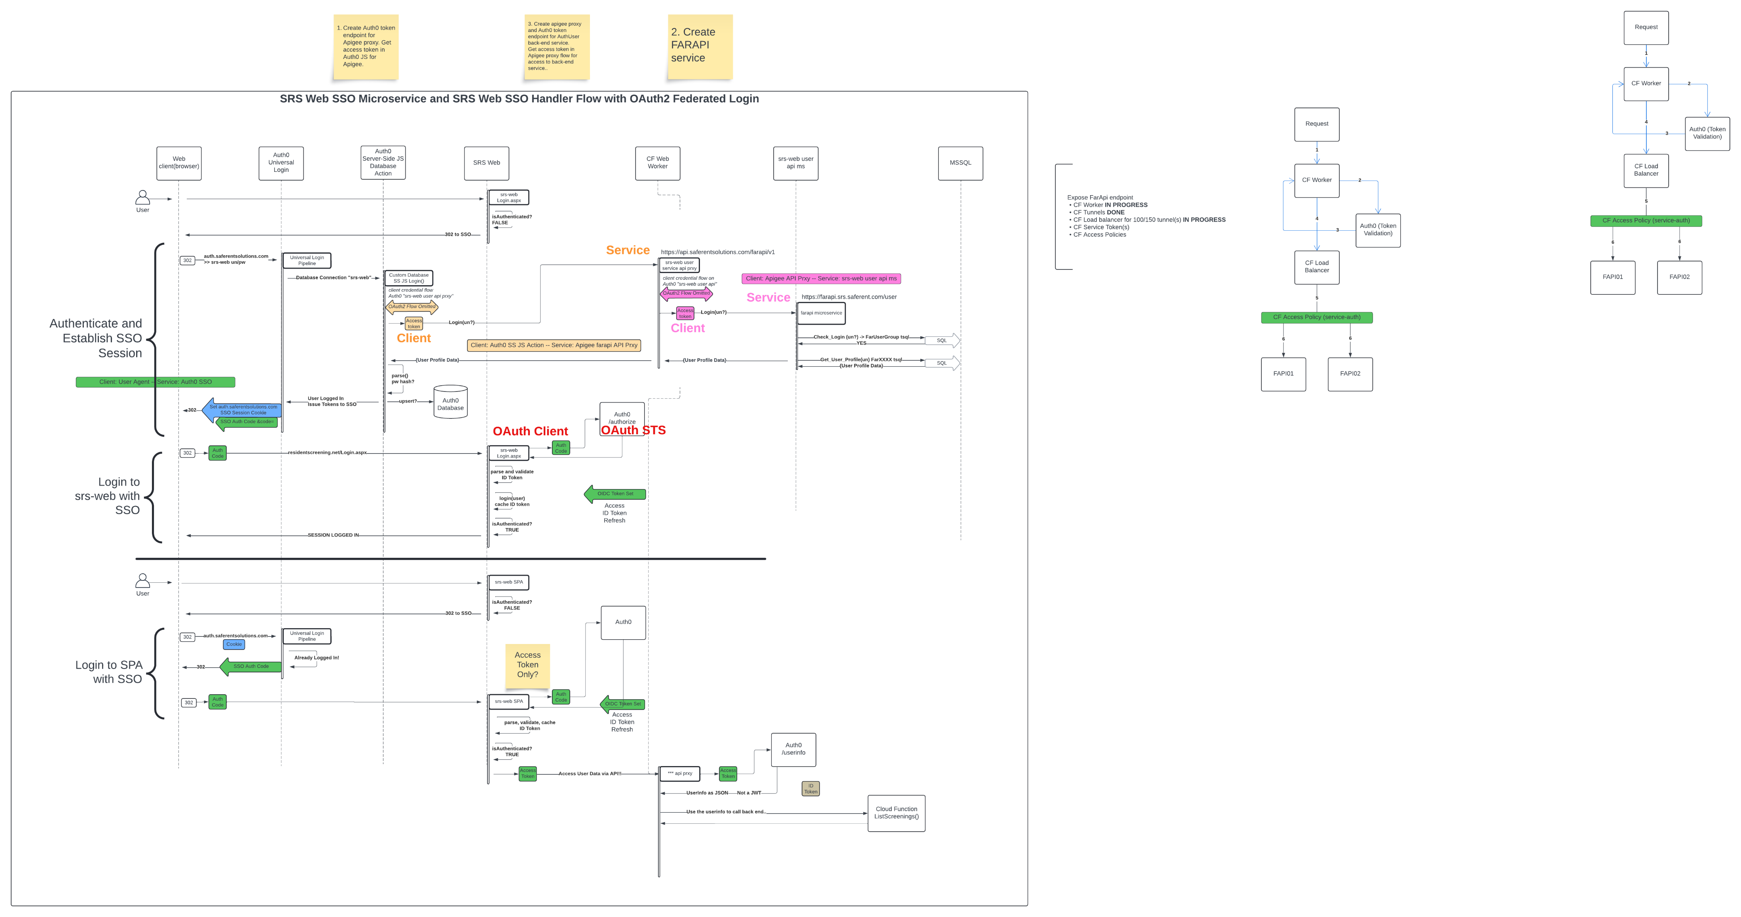
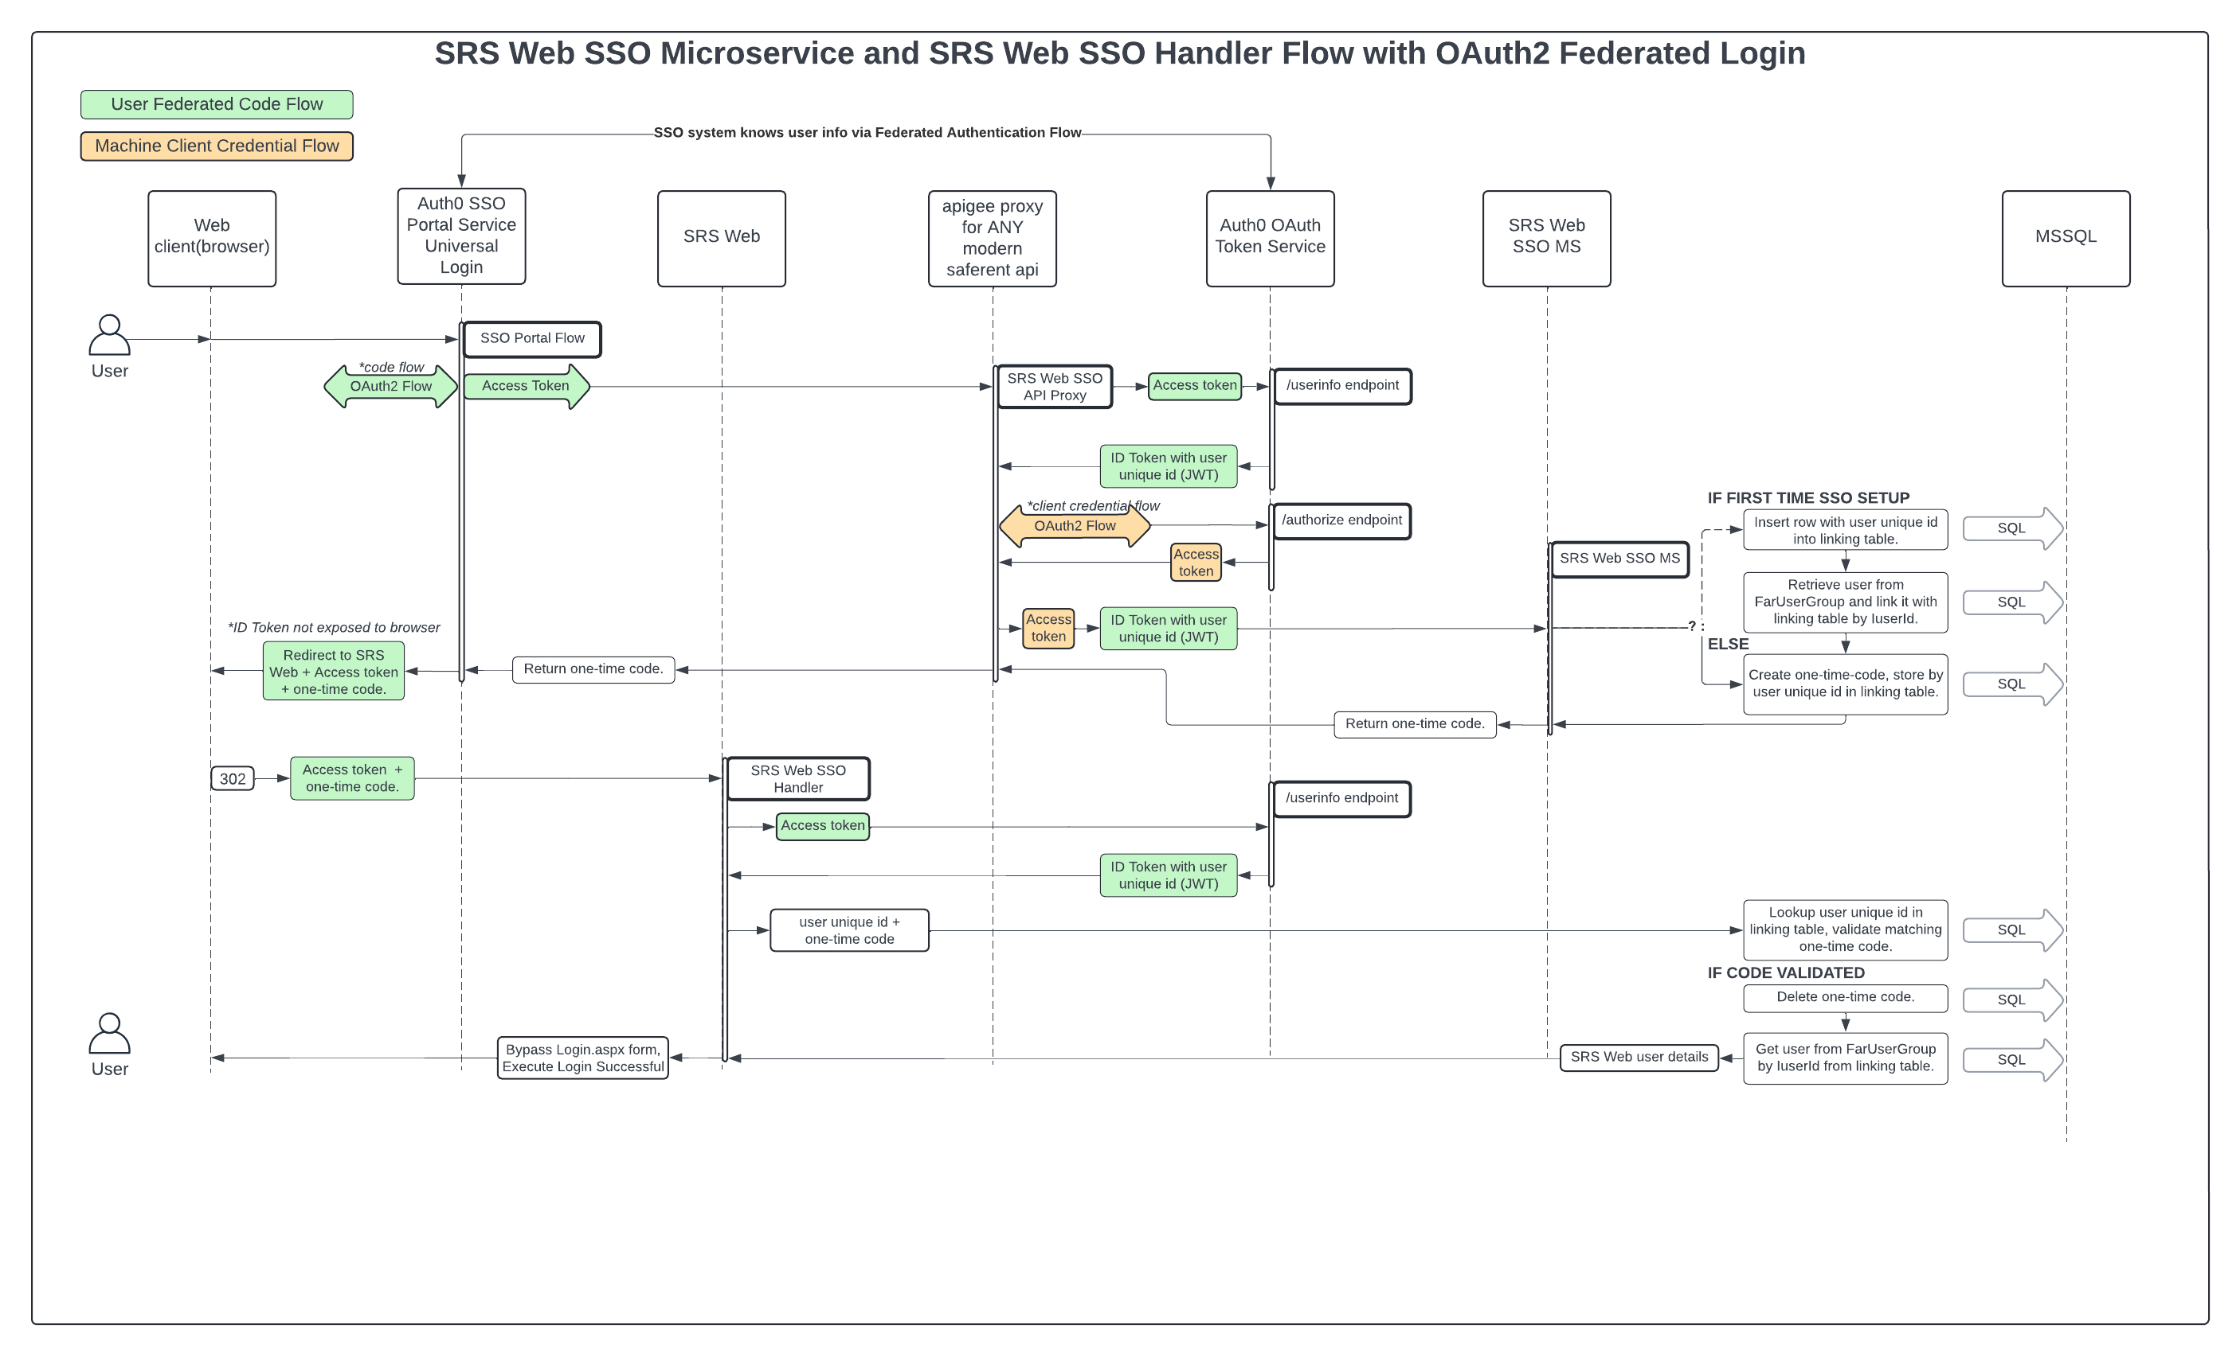
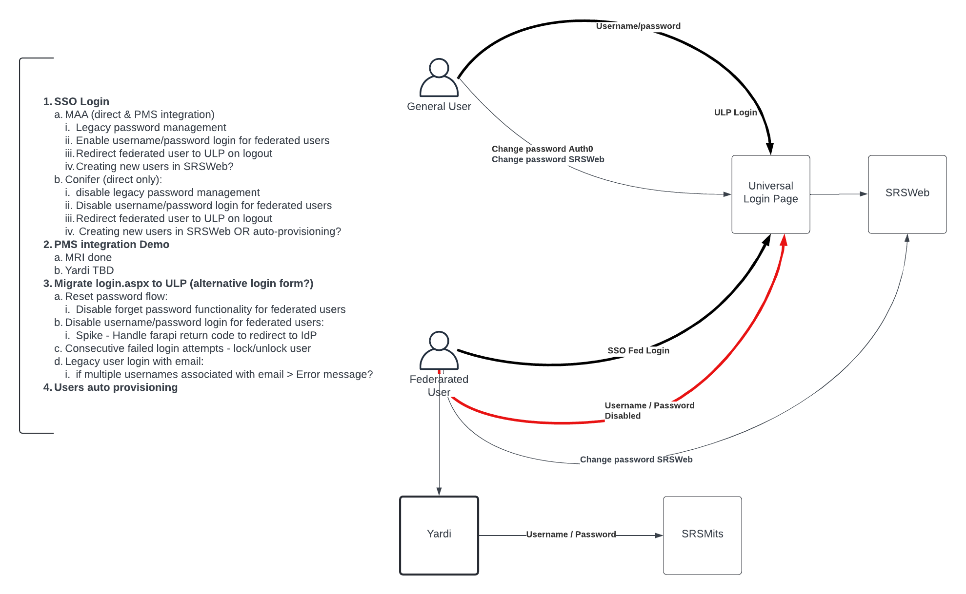
SFRN-DEVT: 2025. Pre-SSO: Ideation phase

Slide 17
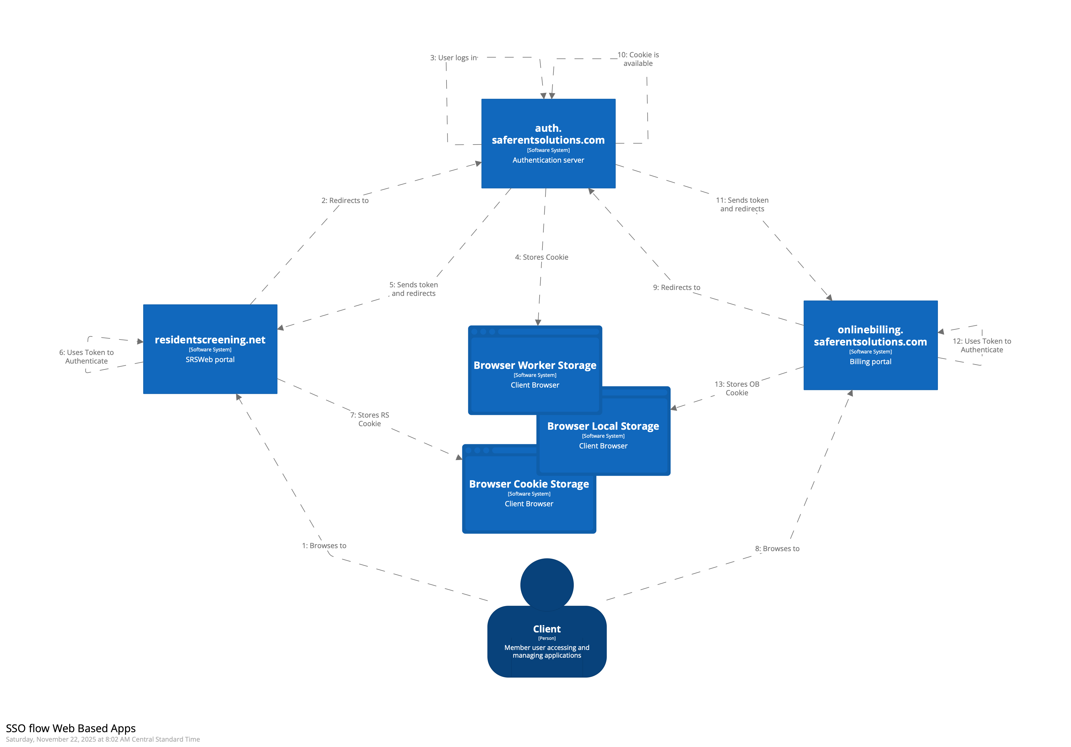
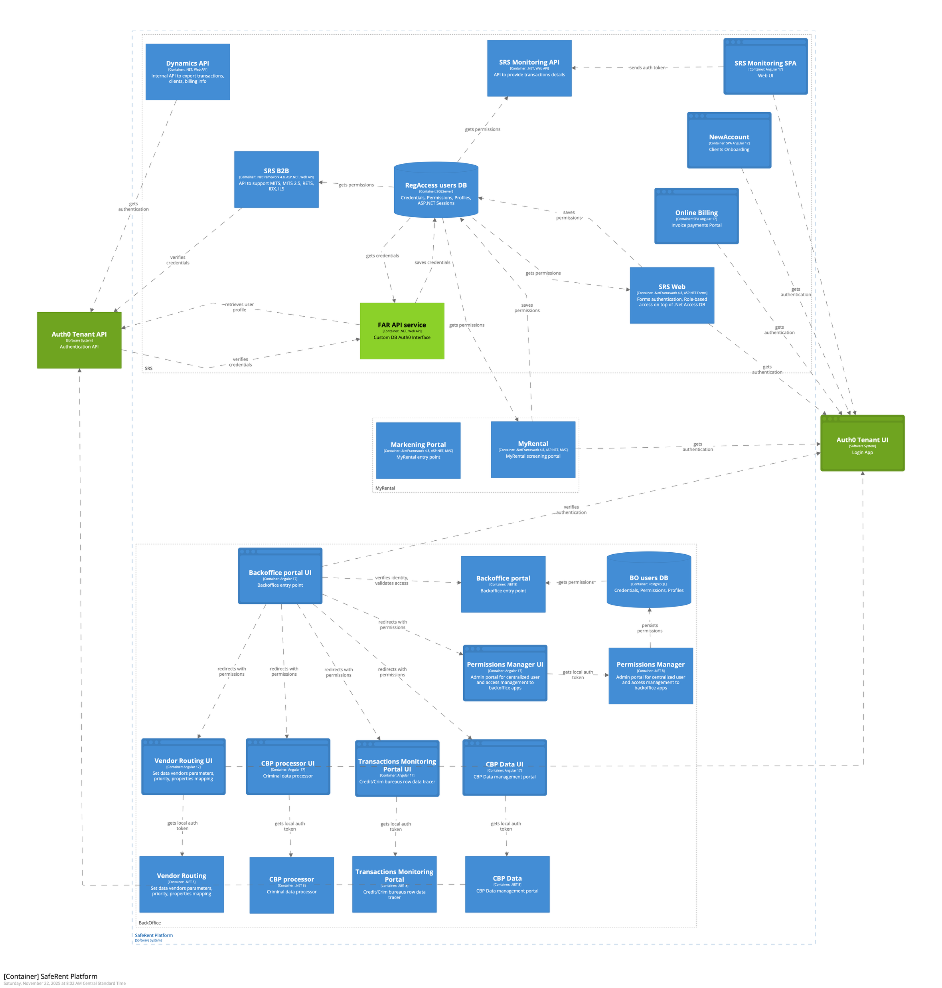
SFRN-DEVT: 2025. SSO Architecture: Implementation
SSO Flow for Web Applications
Container View Enhancements

Slide 18
SFRN-DEVT: 2025. Single Sign-On solution
Full Solution Architecture Document Provided
All diagrams, process flows, architectural views, and explanatory materials created throughout the SSO modernization effort have been consolidated into a dedicated Solution Architecture Document (SAD).
The document captures the complete end-to-end design, including business context, requirements, system views, integration patterns, security model, migration approach, and all supporting diagrams.
The full SAD is included as an attachment to the assessment request so the reviewers can explore the solution in detail beyond the high-level slides presented here.

Slide 19
SFRN-DEVT: executive summary
The organization is entering a long-term modernization phase centered on replacing legacy components through a controlled, incremental approach. The current platform—rooted in aging .NET Framework 4.8 and tightly coupled authentication logic—limits scalability, slows delivery, and increases operational complexity. To overcome these challenges, the company aims to establish a migration framework based on the Strangler Fig pattern, enabling legacy functionality to be gradually replaced by modern services while keeping customer-facing experience uninterrupted.
The NewAccount project serves as a proof of this strategy. By selectively extracting and rebuilding specific business capabilities in a new service architecture, NewAccount demonstrates how individual flows can be decoupled from the monolith and migrated into maintainable, scalable components. However, this process also revealed a major dependency: without a unified and modern authentication mechanism, each new service must rely on outdated security logic, creating additional complexity and limiting the speed of future migrations.
To address this gap, the SSO initiative establishes a secure, centralized identity platform that enables modern authentication and authorization across both legacy and newly developed services. Introducing SSO for even small segments of the SafeRent ecosystem unlocks the ability to modernize the monolithic WebApplication in stages, allowing new components to operate independently while still integrating seamlessly with the existing system.
Together, these efforts form a clear modernization roadmap. The first phase delivers the foundational capabilities—decomposition of legacy functionality, unified authentication, and automated release practices. The second phase focuses on scaling the migration framework, gradually replacing legacy modules, refining service boundaries, and enabling cloud-ready architecture. This strategy reduces operational risk, increases delivery velocity, and provides a sustainable path toward a fully modernized SafeRent platform.

Slide 20
Thank you!

